Slide 1
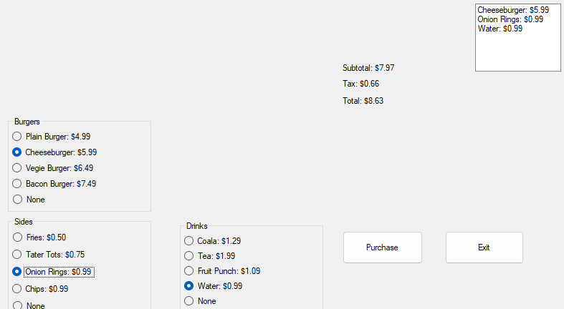
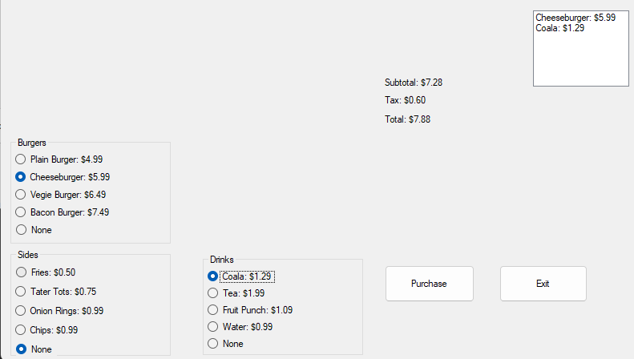
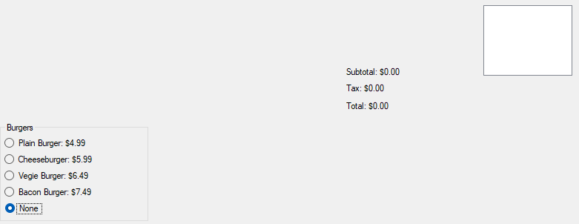
Charlie Hatch’s “Fall” Presentation- 2024
Charlie Hatch’s “Fall” Presentation- 2024
Presented to you by: Charlie Hatch
Before we start, here’s a question. how is this the fall term? I mean, Look at the weather
So, Just a second, let me fix that
There, that’s better

Slide 2
3 prexisting things that got reinforced in core
Ways of dealing with sensory overload
No, I can’t think of them off the top of my head
More information on how your behaviour can affect being hired and promotions
Some other stuff

Slide 3
3 Things I leaned in Tech
How to make a close button which requires a confirmation period
My own invention
How to make multiple buttons be bonded to a single event
How to integrate

Slide 5
Things I learned in
: Club
Club
b Club
bo Club
bot Club
both Club
Club

Slide 6
